Slide 1
Geol 244 – structural geology
Lecture 2 – primary and secondary structures
Introduction to force and stress

Slide 2
Intro cont’d

Slide 3
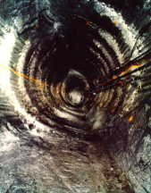
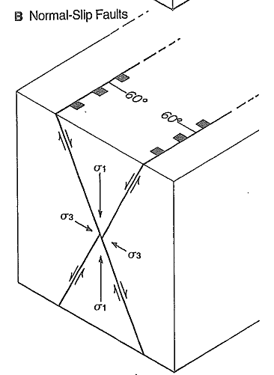
3rd type of structural analysis
Dynamic analysis
Estimation of the force or stress that has affected rocks.
Orientation and magnitude
Can be inferred from
The distribution of rocks, (descriptive analysis)
How they moved to get there (kinematic analysis)
Can be directly estimated by behaviour of rocks in excavations

Slide 4
Primary and secondary structures
Primary structures form with the rock
Do not reflect tectonic stresses
vdP&M Chapter 2
Secondary structures form after the rock
Some are caused by tectonic stresses
Some are caused by gravitational instability

Slide 5
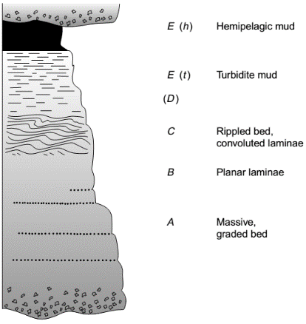
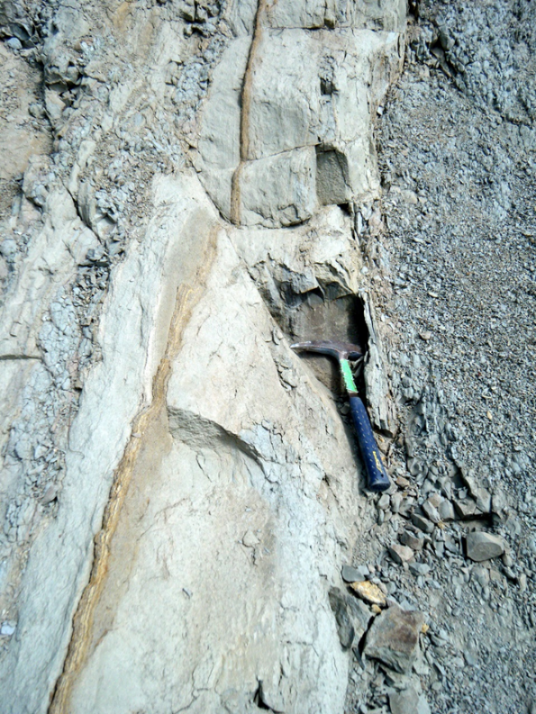
Sedimentary primary structures
Primary structure is bedding
Sedimentary primary structure
Contains other smaller-scale sedimentary structures
Provides way up indications
Secondary structure is fault ….
…. And fold

Slide 6
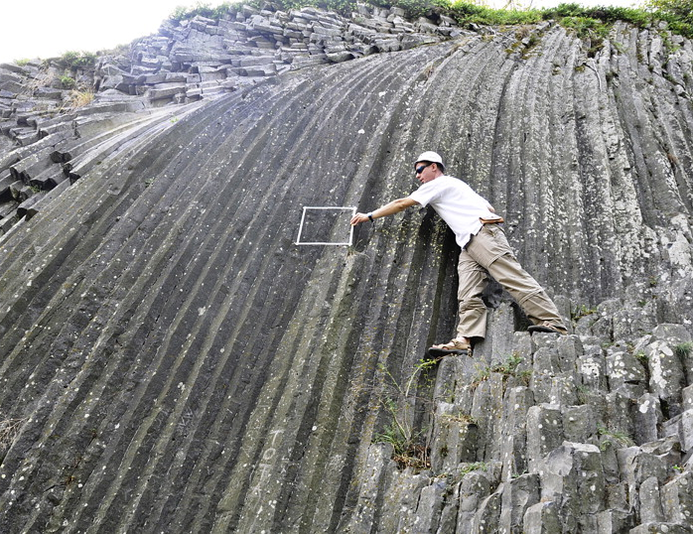
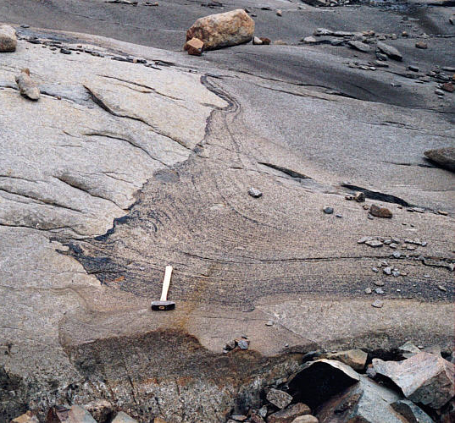
Igneous primary structures
Columnar joints caused by volume reduction during cooling of lava
Layered gabbro caused by settling of denser material, and/or by currents forced to flow around protrusions from the pluton floor
http://dx.doi.org/10.1016/j.jsg.2013.06.007

Slide 7
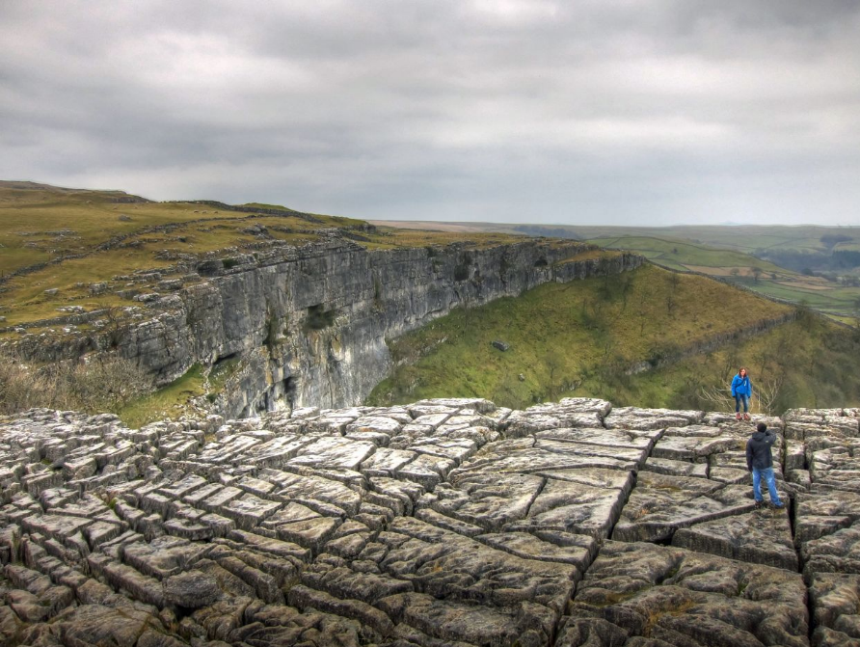
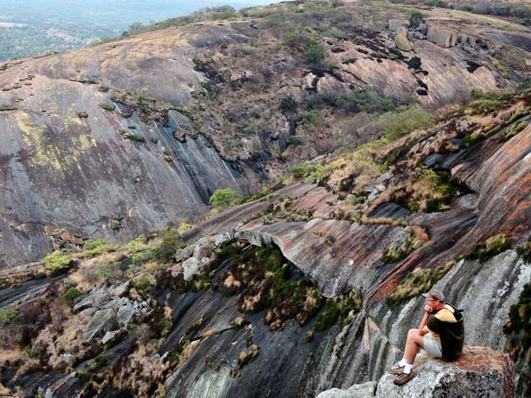
Secondary structures –joints
Intersecting vertical joints at Malham cove, Yorkshire
Parallel with exhuming surface
Horizontal joints at Matopos Hills, Zimbabwe
Sheet joints in granite – caused by unloading

Slide 8
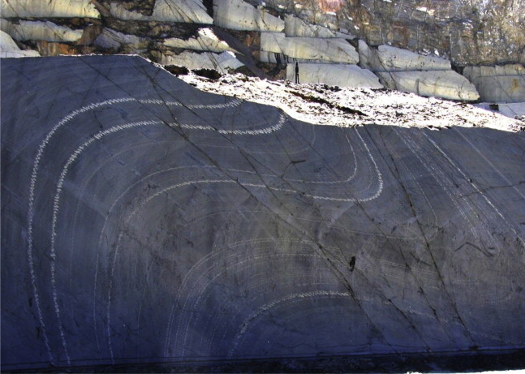
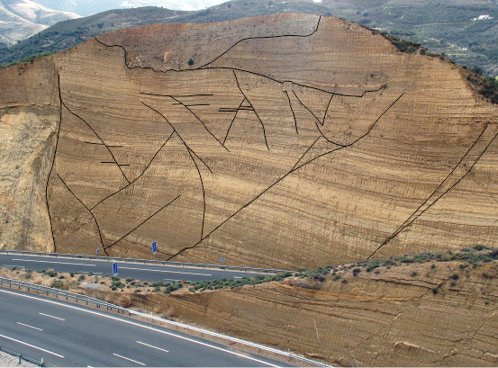
Secondary structures – folds and faults
Folding
Faulting. Beach deposits on right are crosscut by two sets of faults
Folding of this sandstone is ductile – the rock remains intact but bends like putty
Rocks are complex materials that fail in response to stress
The material properties of rocks affect how they deform
affected by factors such as lithology, water content, temperature and depth
Faulting in this sandstone is brittle – the strength of the rock has been exceeded and it has broken

Slide 9
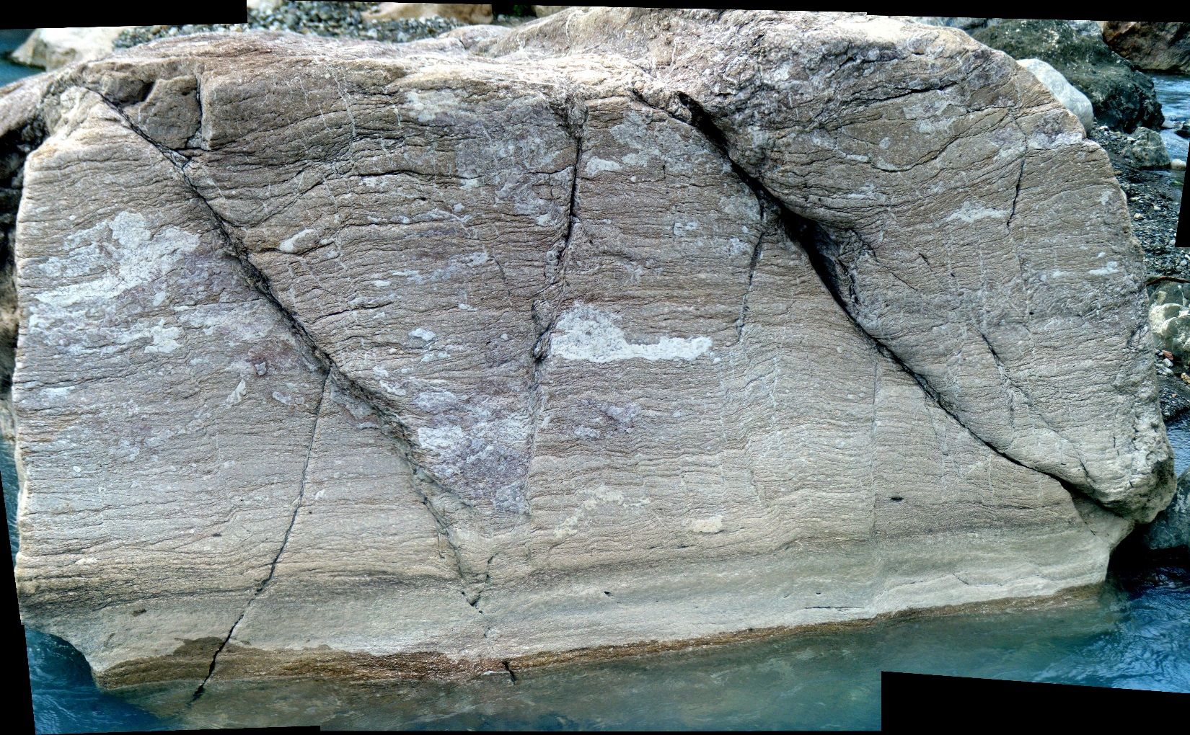
This rock shows two types of failure
What are they?
Both brittle and ductile
Structural geologists want to interpret the history of deformation (strain) in the rocks

Slide 10
If we want to understand these rocks…
We first need to understand some concepts…
Factor |  | Importance
Inputs
Force/stress | Dynamic input
Elasticity | Mechanical and Rheological (time-dependent) properties of the materials being subjected to stress. These, in conjunction with the timescales at which stress is applied, control the material behaviour
Plasticity
Viscosity
Strength
Time | Controls material behaviour in conjunction with rheology
Outputs
Strain/deformation/kinematics | $Y=m∙x$ where Y: deformation; m: rheology (time dependent); and x: force/stress
Material behaviours
Brittle, ductile, elastic, plastic and viscous | Describe the behaviour of given materials in response to force and stress over given time-scales

Slide 11
Strain/deformation/kinematics | $Y=m∙x$ where Y: deformation; m: rheology (time dependent); and x: force/stress
Relationship between stress and strain is modulated by rheology
Rheology 1
Rheology 2
Rheology 3
Rheology 4
Stress
strain

Slide 12
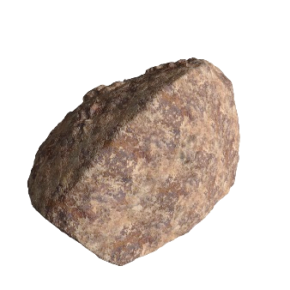
Concept 1 - Force
Force = change in velocity
In the absence of force, a body of given mass moves at constant velocity or is at rest
Velocity is rate of change of distance $\frac{m}{s}$
Force causes a body to accelerate
Acceleration (rate of change of velocity) $a=\frac{δv}{s} = \frac{m/s}{s}$ or ${a=ms}^{−2}$
Force is proportional to the mass and the acceleration
$F=ma=kg ×{ms}^{−2}$
Unit is Newtons (N)

Slide 13
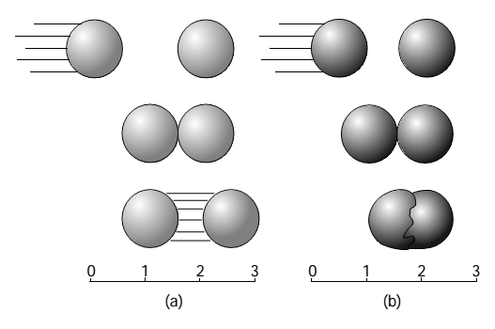
Forces
Forces act on bodies
Interaction of rigid bodies → Newtonian mechanics
Interaction ofDeformable bodies → Continuum mechanics
Rocks are subject to the forces related to internal heat and gravity
Are rocks rigid or deformable?
Newton’s pendulum

Slide 14
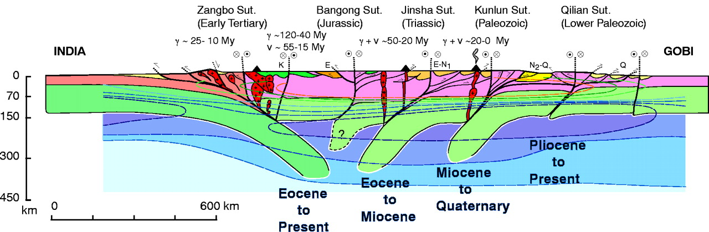
Forces affecting plates
Plate interiors may move at relatively constant velocities, governed by mantle processes = little acceleration
Velocities change rapidly at plate boundaries = large acceleration
Plate boundary forces → deformation
Generally involve distortion as well as movement – ie not Newtonian
Time and distance are important factors when considering whether rocks are rigid or deformable

Slide 15
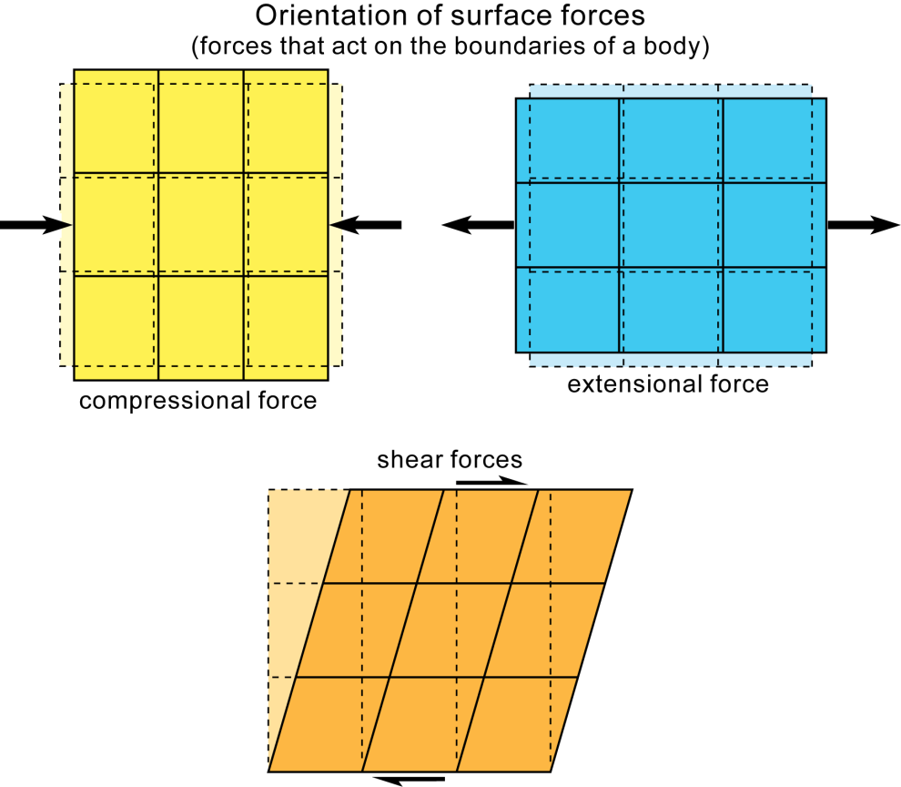
Directed forces
Directed forces act in particular directions
Compression is force that tends to compress bodies
Tension is force that tends to pull bodies apart
Shear is force couple when two forces act in opposite directions in same plane but not along same line
relative to horizontal

Slide 16
Directed forces acting on a plane
Normal component, Fn
Fn = F x cos φ
Force F
φ
adj
hyp
opp
Shear component, Fs
Fs = F x sin φ
Plane
Vectorial decomposition of force applied to plane
into normal and shear components

Slide 17
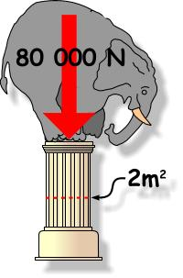
Concept 2 - Stress
Intensity of force
Hang a mass on a spring balance, under influence of gravity, and it yields a force in Newtons
Apply that force to an area, and it exerts a stress in Pascals that is inversely proportional to the areas over which it is applied
$σ = \frac{F (N)}{A (m^{2})}Pa$
σ is stress in Pascals (Pa)
1Pa = 1 kg m⁻¹ s⁻²

Slide 18
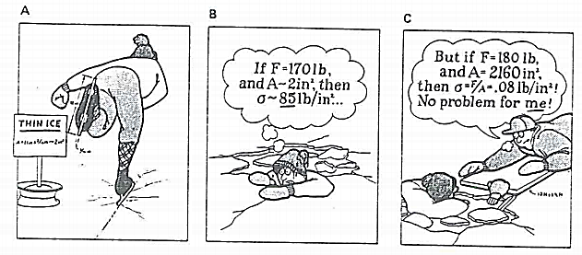
Stress = Force / Area
Equation basically means that the smaller an area is,
the higher the stress is (if Force remains same)

Slide 19
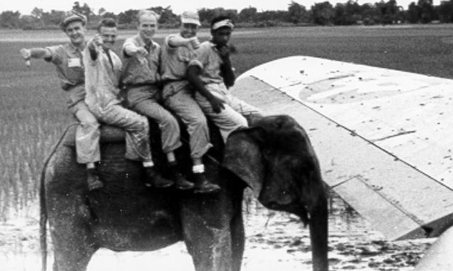
In class exercise – Kate v. Elephant
$σ = \frac{F (N)}{A (m^{2})}Pa$
Who is damaging the runway more?
Princess Kate or an elephant? Which would you prefer to have walking around your flat?
Calculate stress on runway!
± 5%
± 5%
V
Princess Kate:
Mass: 55 kg
Size - small
Heel diameter 0.01 m
Walking style – posh 1 foot on floor
Large Bull Elephant:
Mass: 8000 kg
Size: big
Diameter of foot 0.5 m
Walking style - two feet on ground

Slide 20
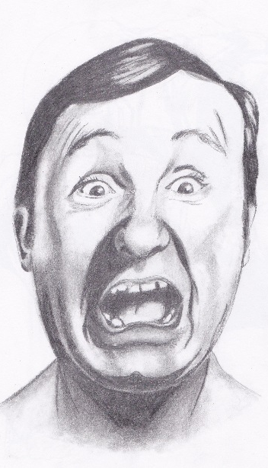
So who will you invite into your flat?
 | M | a | f | area | stress
Kate | 55 | 10 | 550 | 7.85398E-05 | 7002817 | 7MPa
Elephant | 8000 | 10 | 80000 | 0.785398163 | 101859.2 | 1MPa
I am sticking with the elephant

Slide 21
Shear stress varies depending on the inclination of the plane
α is the angle between principle stress σ1 and the plane.
The conjugate shear angle is 2α.
θ is the angle between σ1 and the normal to the plane. (same as φ in force diagram)
Therefore, α and θ add to 90° and 2α + 2θ = 180°
Notes:
It is important to follow conventions when referring to angles between stress and plane

Slide 22
Exercise 2 – resolve normal and shear stresses for differently inclined planes within a cube
A pillar has a square base of 3 m²
The pillar supports a weight with a mass of 15.000 kg
Calculate σ_{N} and σ_{S}, and the ratio of these, for three planes within the pillar
Plane is normal to axis of pillar
Plane at 45° to pillar axis
Plane at 60° to pillar axis
Acceleration of gravity (g = 9.8 m s⁻²);
Next slide has schematic drawing of problem

Slide 23
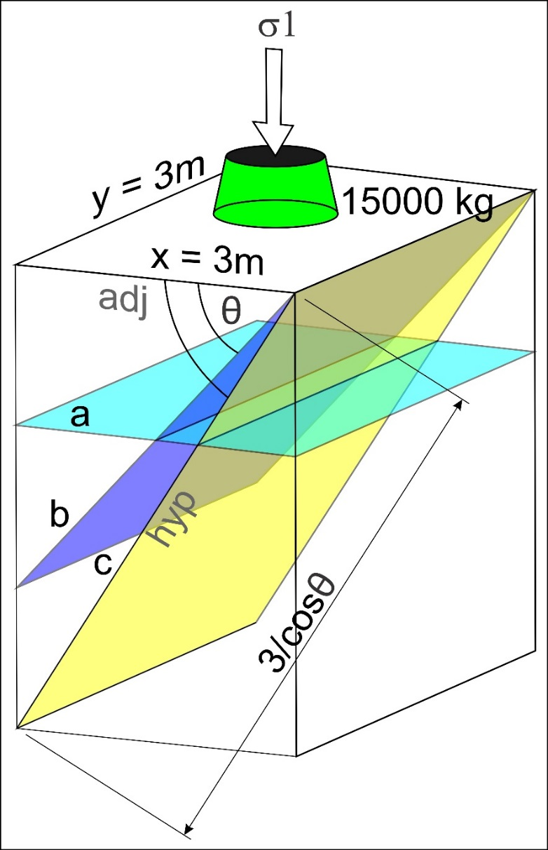
Help for exercise
Calculate the forces
Resolve into normal force and shear force when θ is 0, 45 and 60°
3) Calculate stresses using the area of the plane, which is its down-dip length multiplied by its width
Force
θ
θ
adj
hyp
opp
Opp = Shear force, F _{s} = F sin θ
Adj = normal force, F _{n} = F cos θ
Plane
Area = ……………………….

Slide 24
Answer
A:
σ = (15000 x 9.8) / 9 = 16333.3 Pa
σ_{n} = 16.3 kPa; σ_{s} = 0; ratio = 0
B:
σ = (15000 x 9.8) / (3 x 3/cos45) = 11549 Pa
σ_{n} = σ x cos (45°) = 8.2 kPa
σ_{s} = σ x sin (45°) = 8.2 kPa
Ratio = 1
C:
s = (15000 x 9.8) / (3 x 3/cos60) = 8166 Pa
σ_{n} = σ x cos (60°) = 4.08 kPa
σ_{s} = σ x sin (60°) = 7.07 kPa
Ratio = 1.73

Slide 25
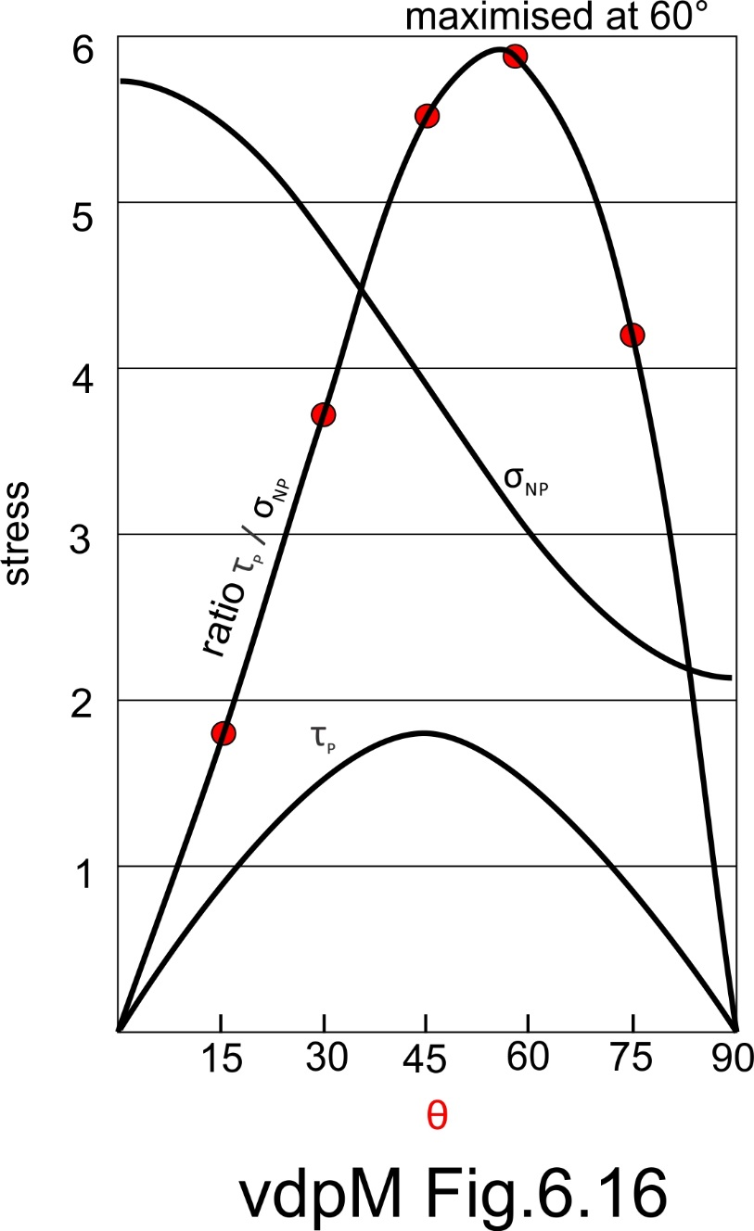
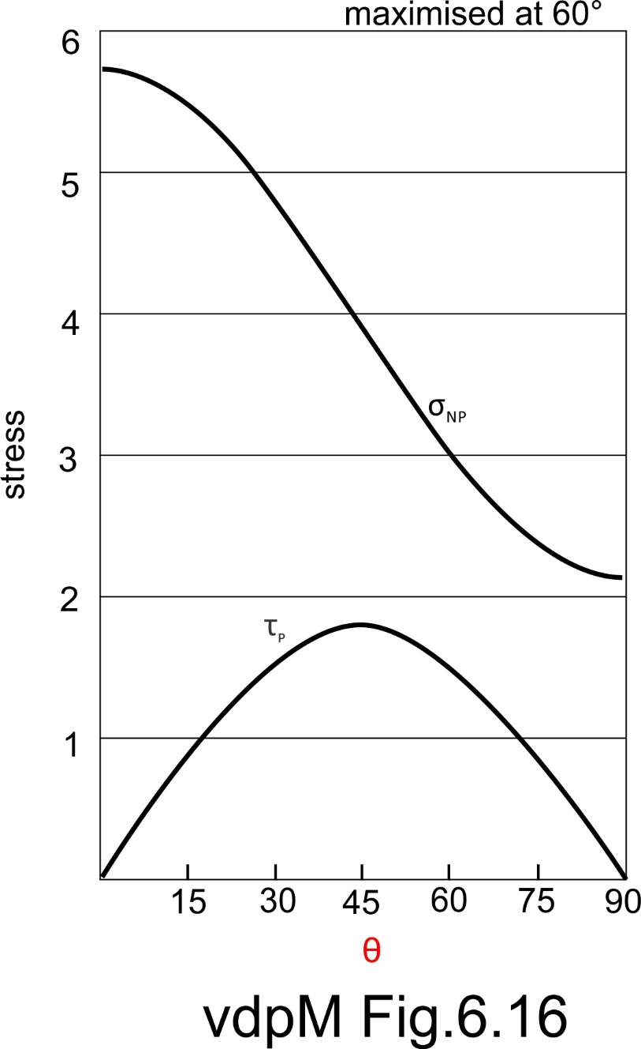
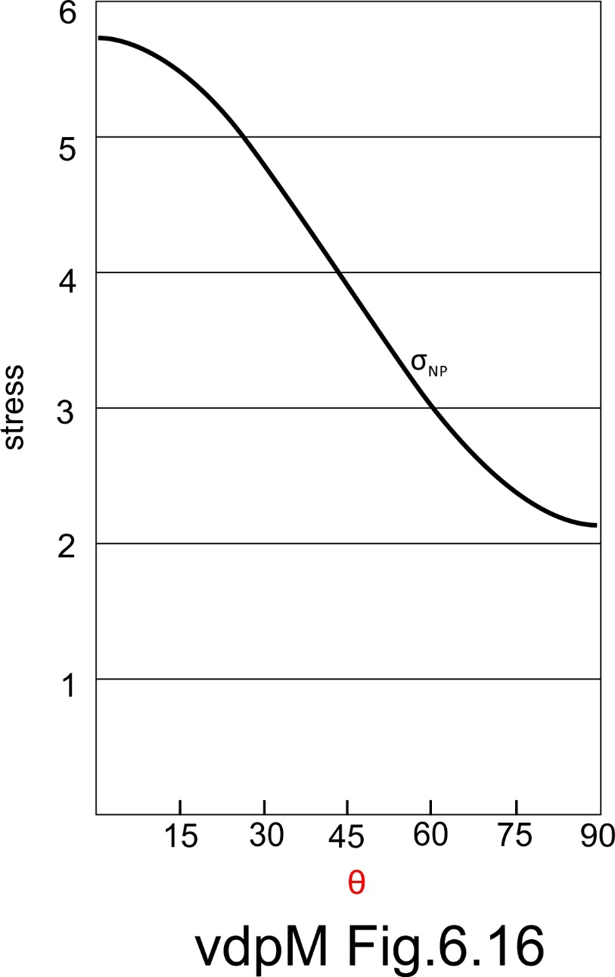
Shear and normal stress and the inclination of the plane
As plane steepens past 45°, area increases dramatically – stress magnitudes drop
Normal stress is at max when θ = 0°
Shear stress is at max when θ = 45°
Ratio of shear stress to normal stress is greatest when θ ~60°
θ is the angle between σ1 and the normal to the plane.

Slide 26
Revising? Be sure that you can explain:
The difference between structural geology, tectonics and geodynamics
Scales and focus
The three types of structural analysis
Descriptive, kinematic and dynamic
The difference between primary and secondary structures, with examples
The difference between non-tectonic and tectonic secondary structures
Force, stress and the difference between them
How stress is resolved onto a plane and why shear stress is maximized on a plane inclined at 45°to the inclination of the plane

